Slide 1
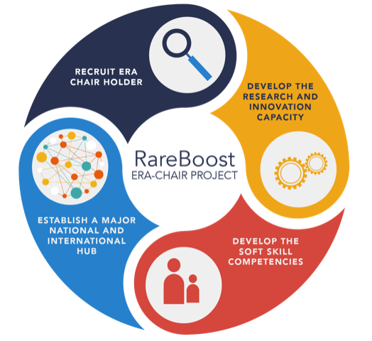
RareBoost Project
Funded by European Union Horizon 2020 ERA Chairs grant (#952346) (Project period: 1.10.2020 – 30.9.2026)
RareBoost project aims to transform IBG into a center of excellence in Rare Disease research and innovation, focusing on four fundamental components listed in the RareBoost logo.
Prof. Uğur Özbek joined RareBoost as the ERA Chair.
A Rare and Undiagnosed Diseases Platform (RUDiP) has been established at IBG.
https://rareboost.ibg.edu.tr/
https://www.ibg.edu.tr/research-programs/groups/ibg-rare-diseases/
Notes:
My main mission is to align the IBG’s already existing research capacity for rare disease research efforts, specifically on the molecular mechanisms behind rare genetic diseases and developing novel solutions.
By this mission, our vision is to execute top quality research to uncover the mechanisms underpinning rare genetic diseases and to implement these findings to develop novel therapeutic treatments.

Slide 2
RareBoost Projesi
Avrupa Birliği Ufuk 2020 “ERA Chairs” hibesi ile finanse edilmiştir. (Proje no. 952346) (Proje dönemi: 1.10.2020 – 30.9.2026)
RareBoost projesi, RareBoost logosunda listelenen dört temel bileşene odaklanarak, IBG'yi Nadir Hastalık araştırmaları ve inovasyonunda bir mükemmeliyet merkezine dönüştürmeyi amaçlar.
Proje başkanlığını Prof. Dr. Uğur Özbek yapmaktadır.
Proje kapsamında, İBG'de Nadir ve Tanısız Hastalıklar Platformu (RUDiP) kurulmuştur.
https://rareboost.ibg.edu.tr/
https://www.ibg.edu.tr/research-programs/groups/ibg-rare-diseases/
Notes:
My main mission is to align the IBG’s already existing research capacity for rare disease research efforts, specifically on the molecular mechanisms behind rare genetic diseases and developing novel solutions.
By this mission, our vision is to execute top quality research to uncover the mechanisms underpinning rare genetic diseases and to implement these findings to develop novel therapeutic treatments.

